Slide 1
GPA Study
Kristina Leonard
Steven Jones
Jianheng(Jansen) Zhang
Jarrett Luthy
Spring 2011
5/2/2011

Slide 2
Introduction
Question:
What is the main factor of college GPA?
What do we do?
Survey 100 students at Stephen F. Austin State University

Slide 3
Factor that we consider:
SAT/ACT
HSGPA
HR of work
If tuition paid by yourself
If tuition paid by parent
Night of party per week
Drink per week
HR of working out per week
Video Entertainment
HR of Social Network spending per week
HR of AARC per week

Slide 4
Data Description

Slide 5
Test Hypotheses
At the 95% confidence level, did our model helps explain GPA for students surveyed at Stephen F. Austin State University as modeled?

Slide 6
Test Hypotheses
I don’t know how to do on this left tail test. I found out some mistake here. Please fix this slide so that you know how to present it.

Slide 7
Test Hypotheses
I don’t know how to do on this right tail test. I found out some mistake here. Please fix this slide so that you know how to present it.
Please Steven fix both left and right tail text hypotheses in this ppt file(I think both are fail to reject then there is not enough evident that……)

Slide 8
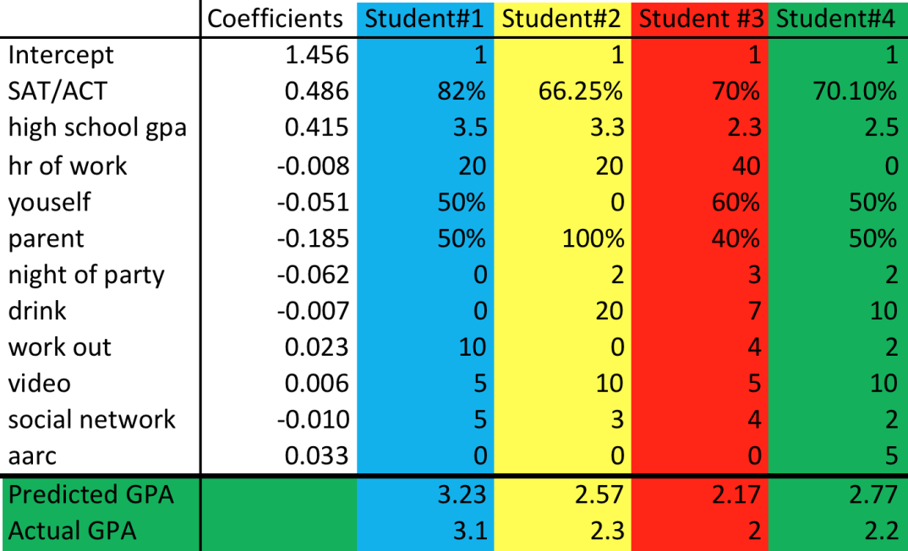
Prediction

Slide 9
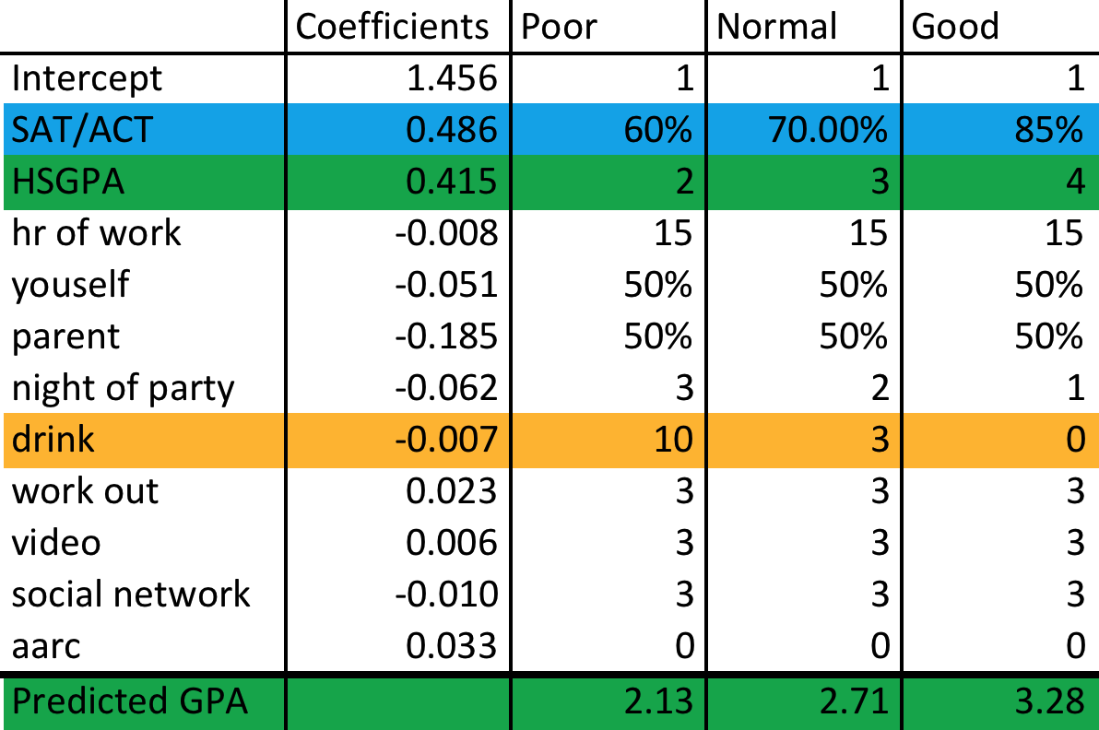
Prediction

Slide 10
Conclusion

Slide 11
Conclusion
SAT/ACT
HSGPA
Work out
Video
AARC
HR of work
Youself
Parent
Night of party
Drink
Social network

Slide 12
How do we improve?
Add a few questions such as
how hard a student works to achieve an A in a class
Add 400 more data to the sample

Slide 13
Thank you!

